Slide 1
Investigating the Queueing Side Channel in Modern Web Browsers
By Dr. Ben Berg, Kiavash Satvat, Joshua Harrell

Slide 2
Outline
Background Information
Motivation: Browser Privacy isn’t Perfect
What is Queueing Theory
Methodology
Analysis
Future Work

Slide 3
Picture this
Research
Commutate
Online Shopping
Store Information
Bank
Gaming
Notes:
The internet is ubiquitous in our modern life
We use the internet for a lot of sensitive and private tasks
Browser privacy is crucial

Slide 4

Your privacy is always under constant attack:
Companies
Special Interest
Next door Neighbor

Slide 5

Browser Fingerprinting
User agent strings
Browser Plugins and Extensions
Installed Fonts
HTTP Headers
Screen Resolutions
Timezone and language settings
Notes:
is a unique identifier generated by collecting and analyzing various attributes of a user's browser and device, which can be used to track and identify users across different web sessions.

Slide 6
Browser Fingerprinting
User agent strings
Browser Plugins and Extensions
But!!! Fingerprinting are not always accurate
Installed Fonts
HTTP Headers
Screen Resolutions
Timezone and language settings

Slide 7
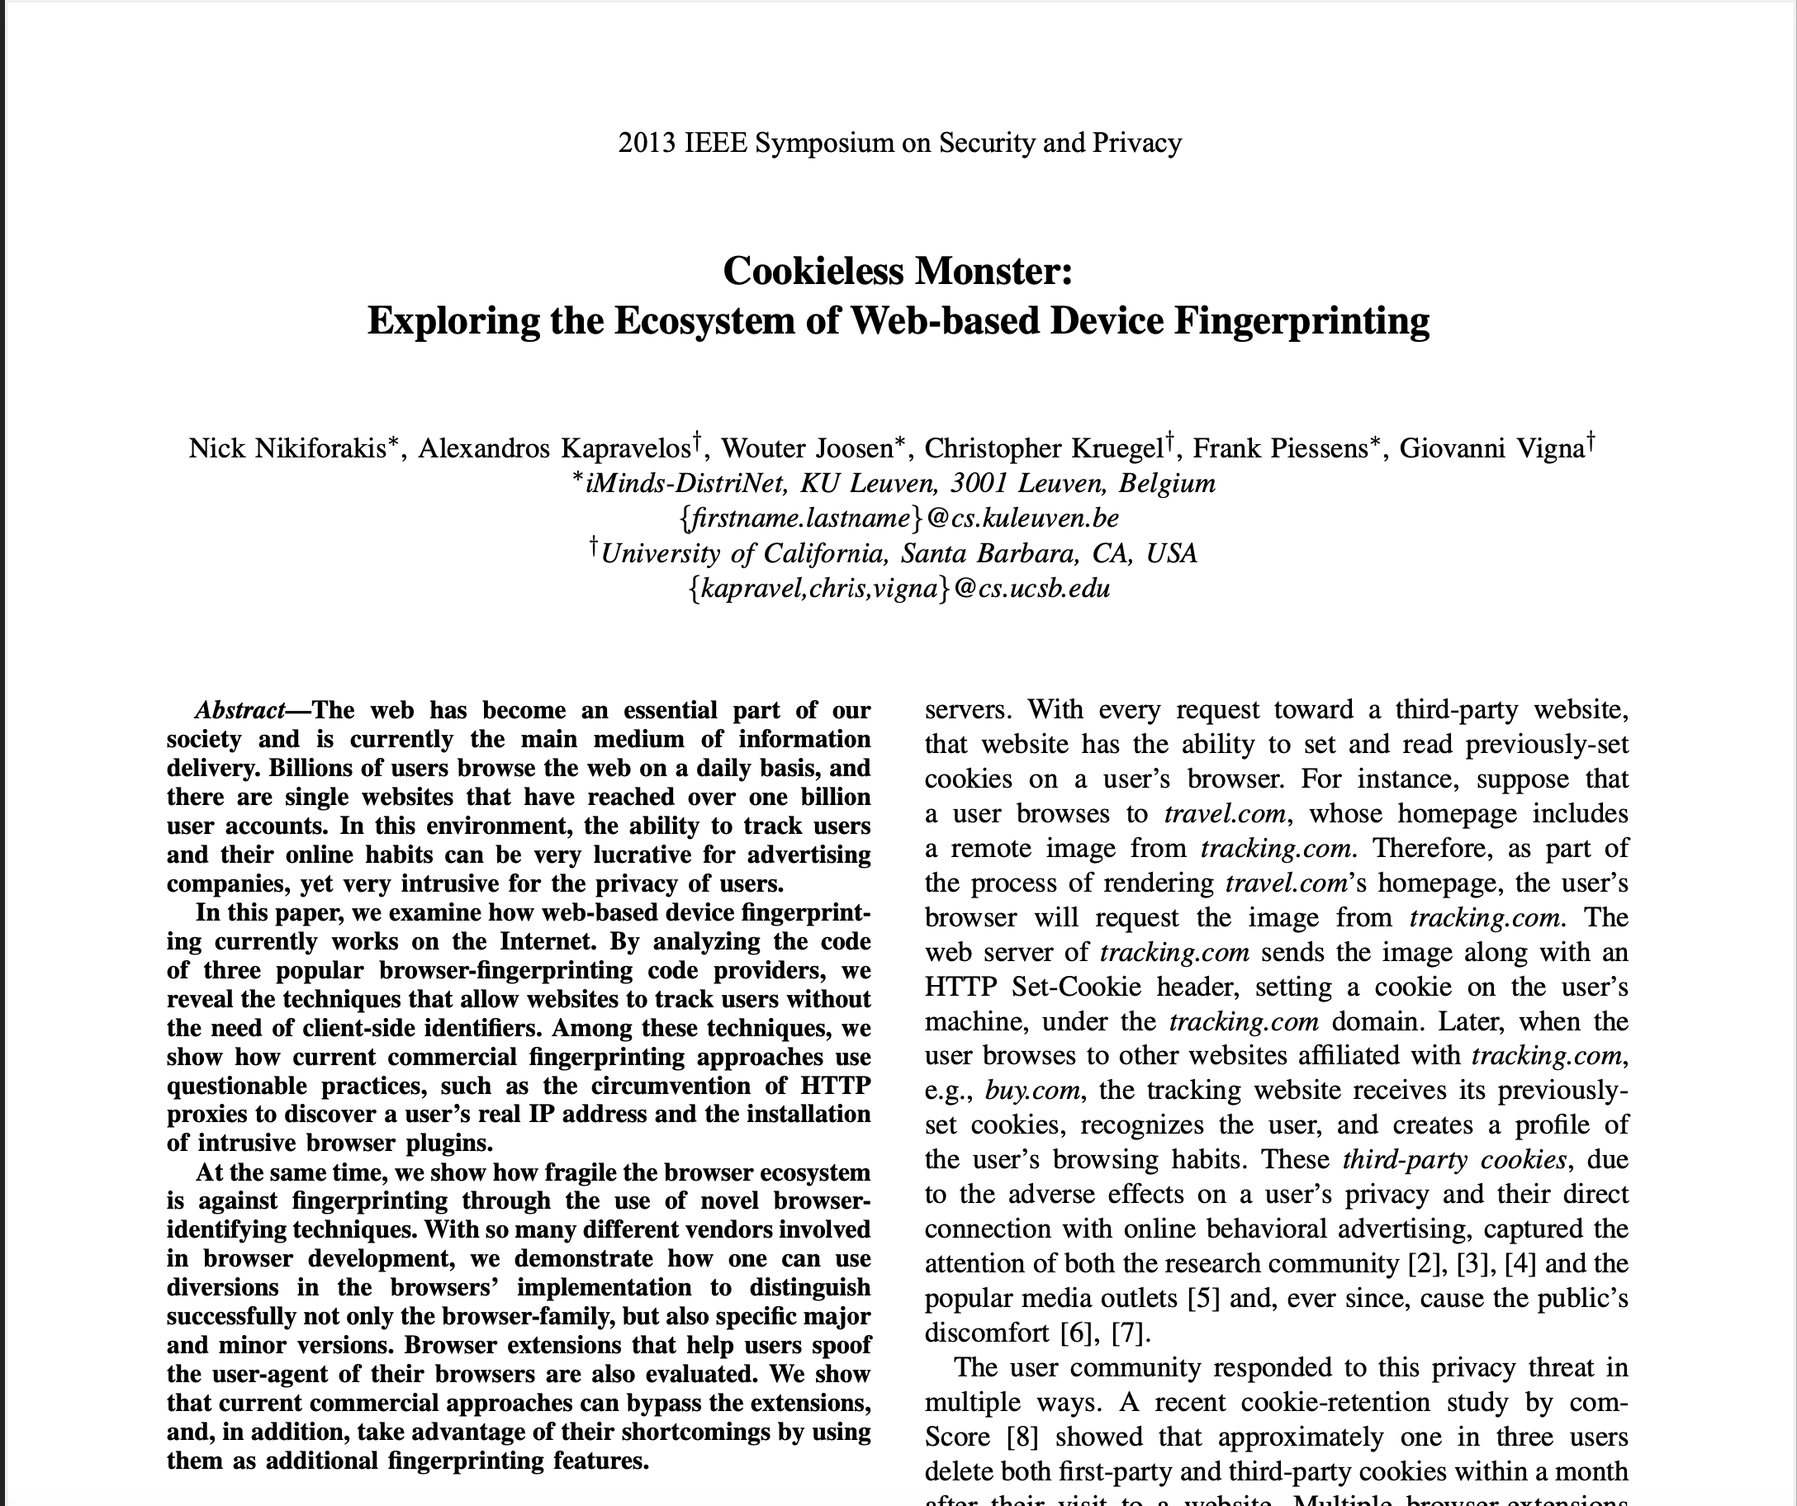
According to....
Using JavaScript and Flash, researchers were able to uniquely identify users 80% of the time through their browsers

Slide 8
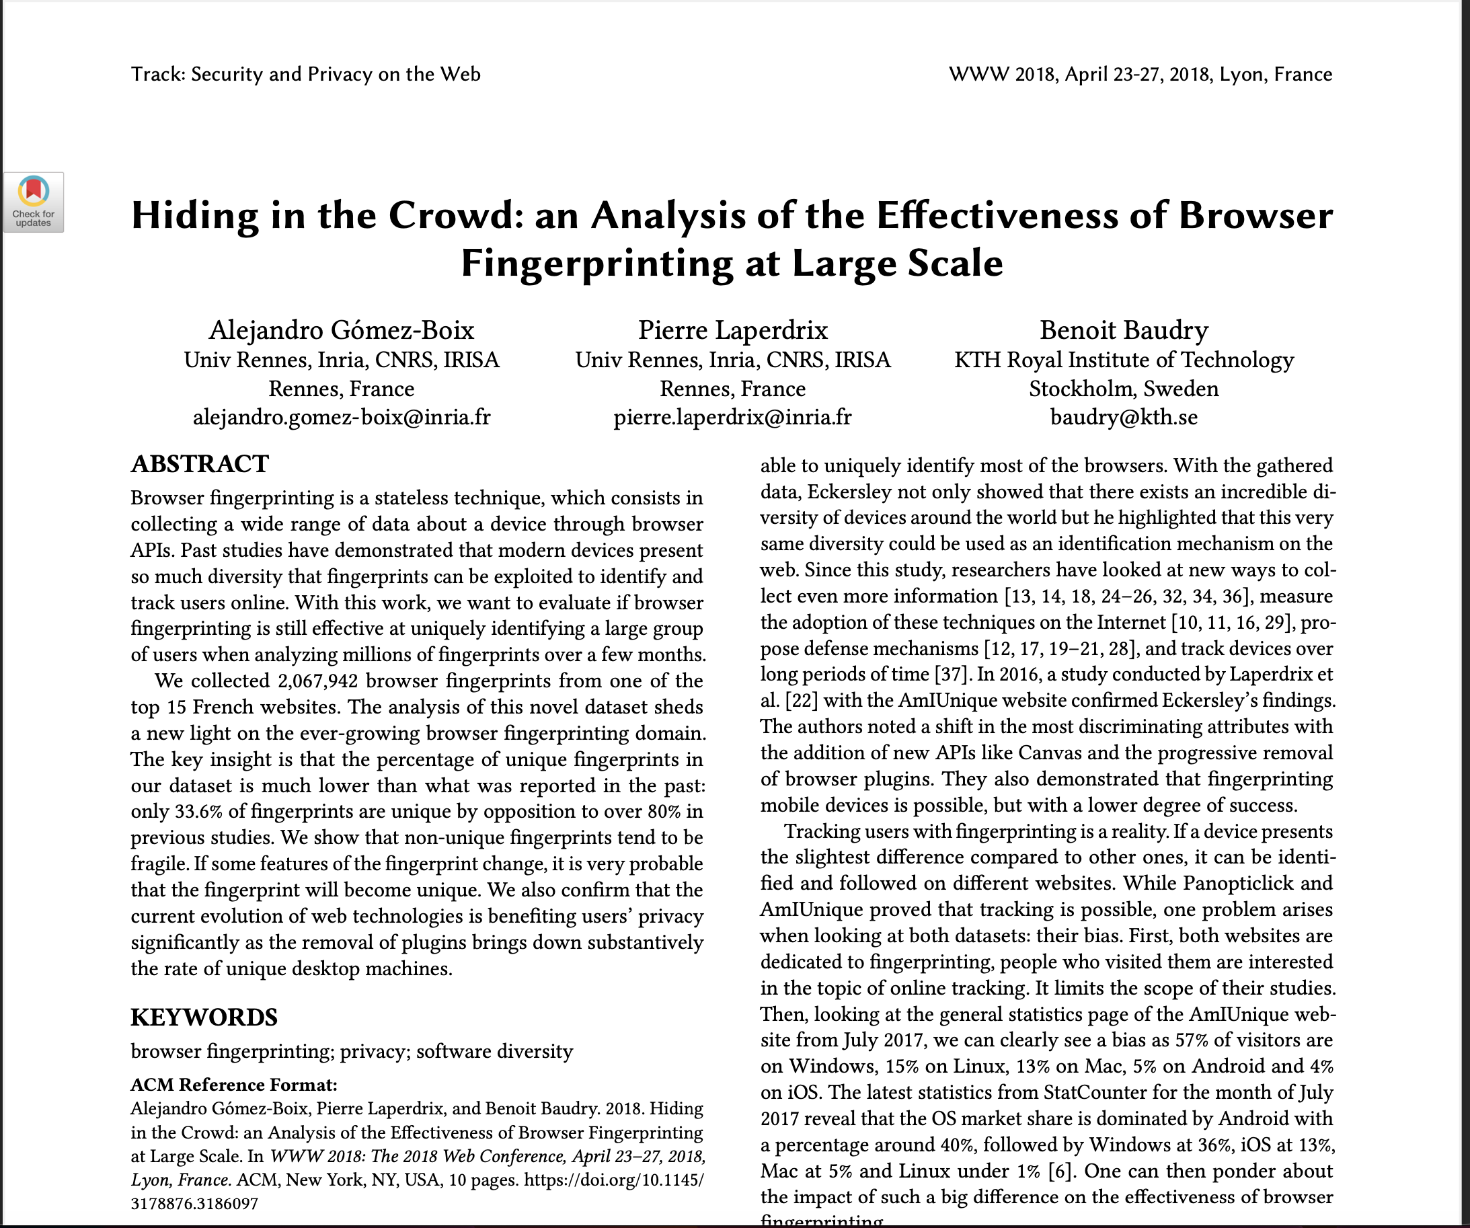
According to....
By analyzing over 2 million fingerprints and found that only 33.6% of users could be uniquely identified.
Notes:
So, effectives as gone down for time, this has led to adversary look that other ways of getting information such as through side-channels

Slide 9

Side Channel
A property of a system that an attacker can measure to learn information
Notes:
One of these side-channel are queues

Slide 10

Queues represent a side-channel
Tab 1
Rendering Engine
Tab 2
Notes:
Computations at various points in the system are sent to a shared queue, where interference between different tabs can occur. This interference can act as a side channel, allowing insight into other jobs in the queue and sensing the presence of other jobs.

Slide 11

But queues give limited feedback….
Tab 1
Tab 2
Notes:
The adversary only sees part of the picture: they know their total wait time in the queue but cannot see the individual jobs, before them or their actions and their durations.
So, if I’m an adversary, the question is, what can I learn from the queue and can I send specific kinds of works at specific intervals to learn as much information as possible about others in the system, and is this actually threat

Slide 12
But queues give limited feedback….
Tab 1
Response Time
Tab 2
Notes:
Yes, because they can measure the mean response time of the jobs in the queue.
Response Time is ” is the total time that the job spends in the system from arrival to departure.”
Mean Response Time “is is the average response time of all jobs in the queueing system over a specific period.”

Slide 13

Research Question
Given limited feedback, can tab two violate tab one’s privacy?
Notes:
how could we see this and measure it?
we measure it by a theory called Queueing Theory

Slide 14
Queueing Theory
Arrival rate(λ)
Tab 1
Tab 2
Notes:
Queueing theory is the mathematical study of how effective a queue can be
Queueing Theory uses mathematical models to predict both the average response time of jobs in a system and the variability around that average.

Slide 15
Queueing Theory
Queue length (L)
Tab 1
Tab 2

Slide 16
Queueing Theory
Tab 1
Wait time(W)
Tab 2

Slide 17
Queueing Theory
Tab 1
Wait time(W)
Tab 2

Slide 18
Queueing Theory
Tab 1
Wait time(W)
Tab 2

Slide 19
Queueing Theory
Tab 1
Service time (s)
Tab 2

Slide 20
Queueing Theory
Tab 1
Departures
Tab 2
Notes:
By understanding how long jobs spend in service and their arrival patterns, it helps estimate not only the average wait times but also the distribution of these wait times, accounting for variations in system load and job processing.

Slide 21
New Question
Given limited event timings can a chrome extension learn about a browser tabs ?
Notes:
By understanding the process of how a website renders, we can time each part; specifically, the rendering queue which can act as a side channel and be used to gather information but how would you go about this
The answer is yes how is it can do this is by next slide

Slide 22
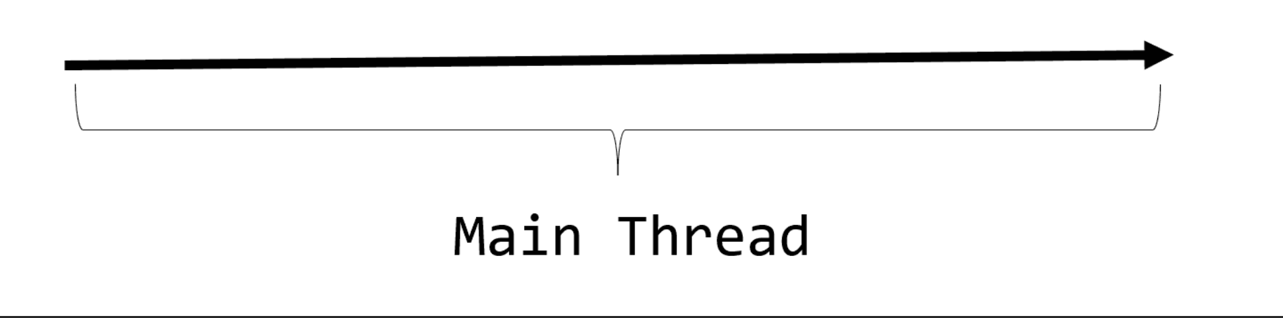
Event Loop

Slide 23
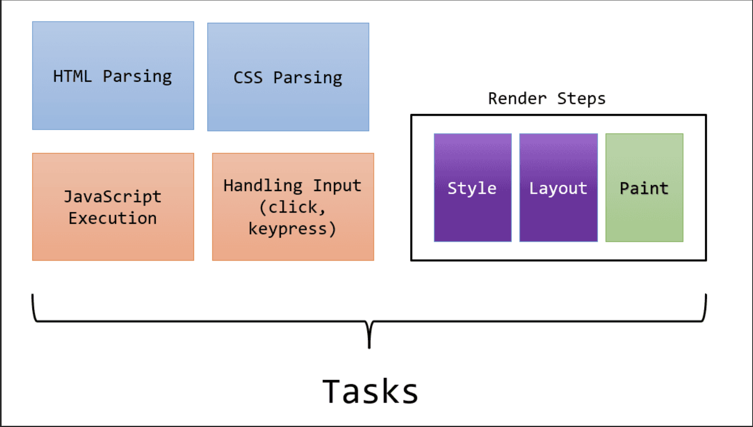

Slide 24
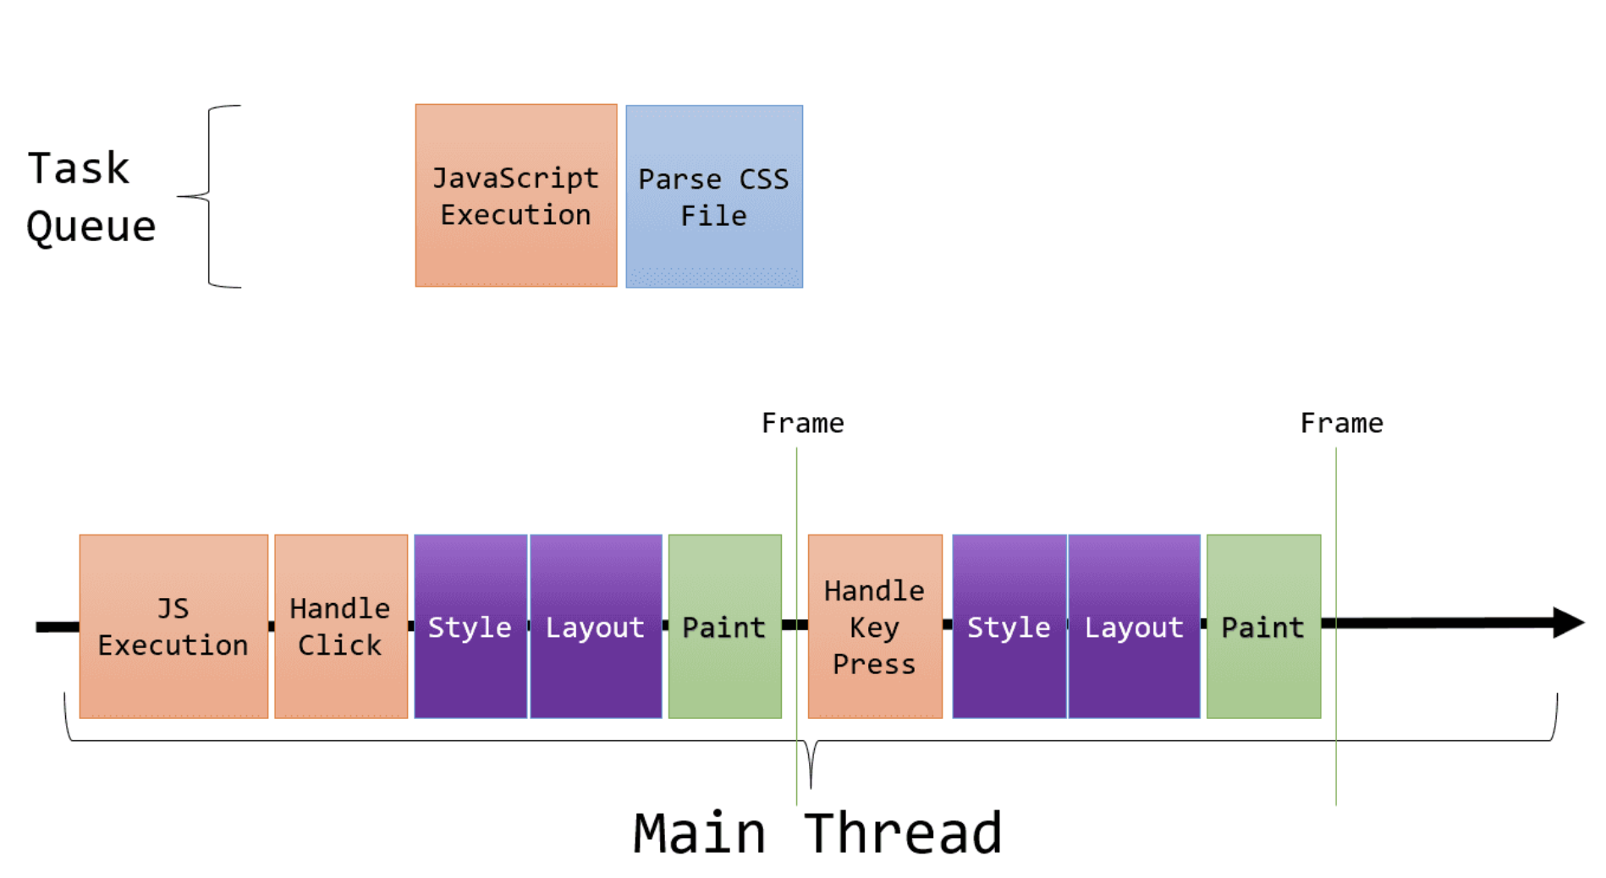

Slide 25





Extension Pipeline

Slide 26
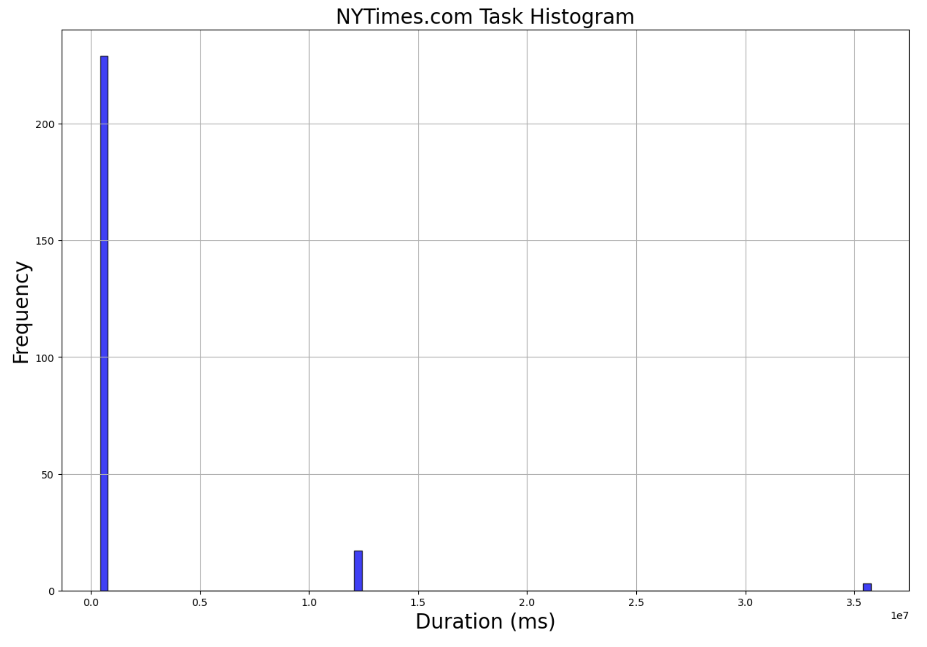
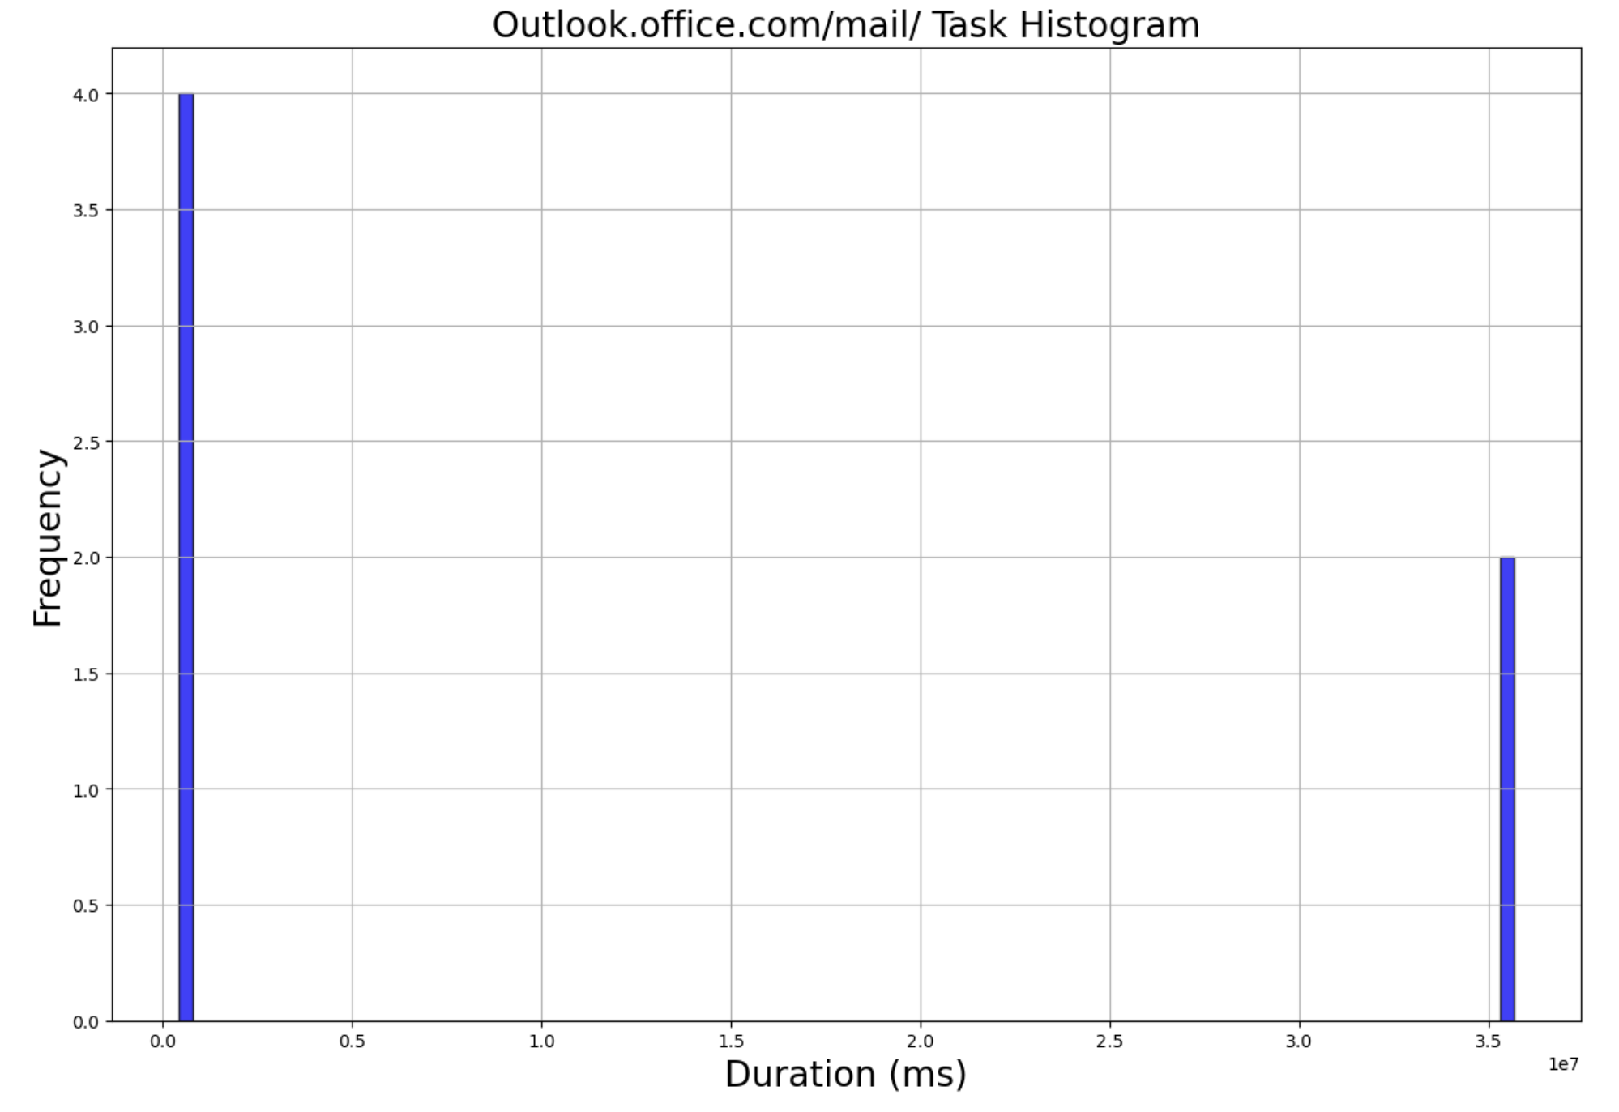
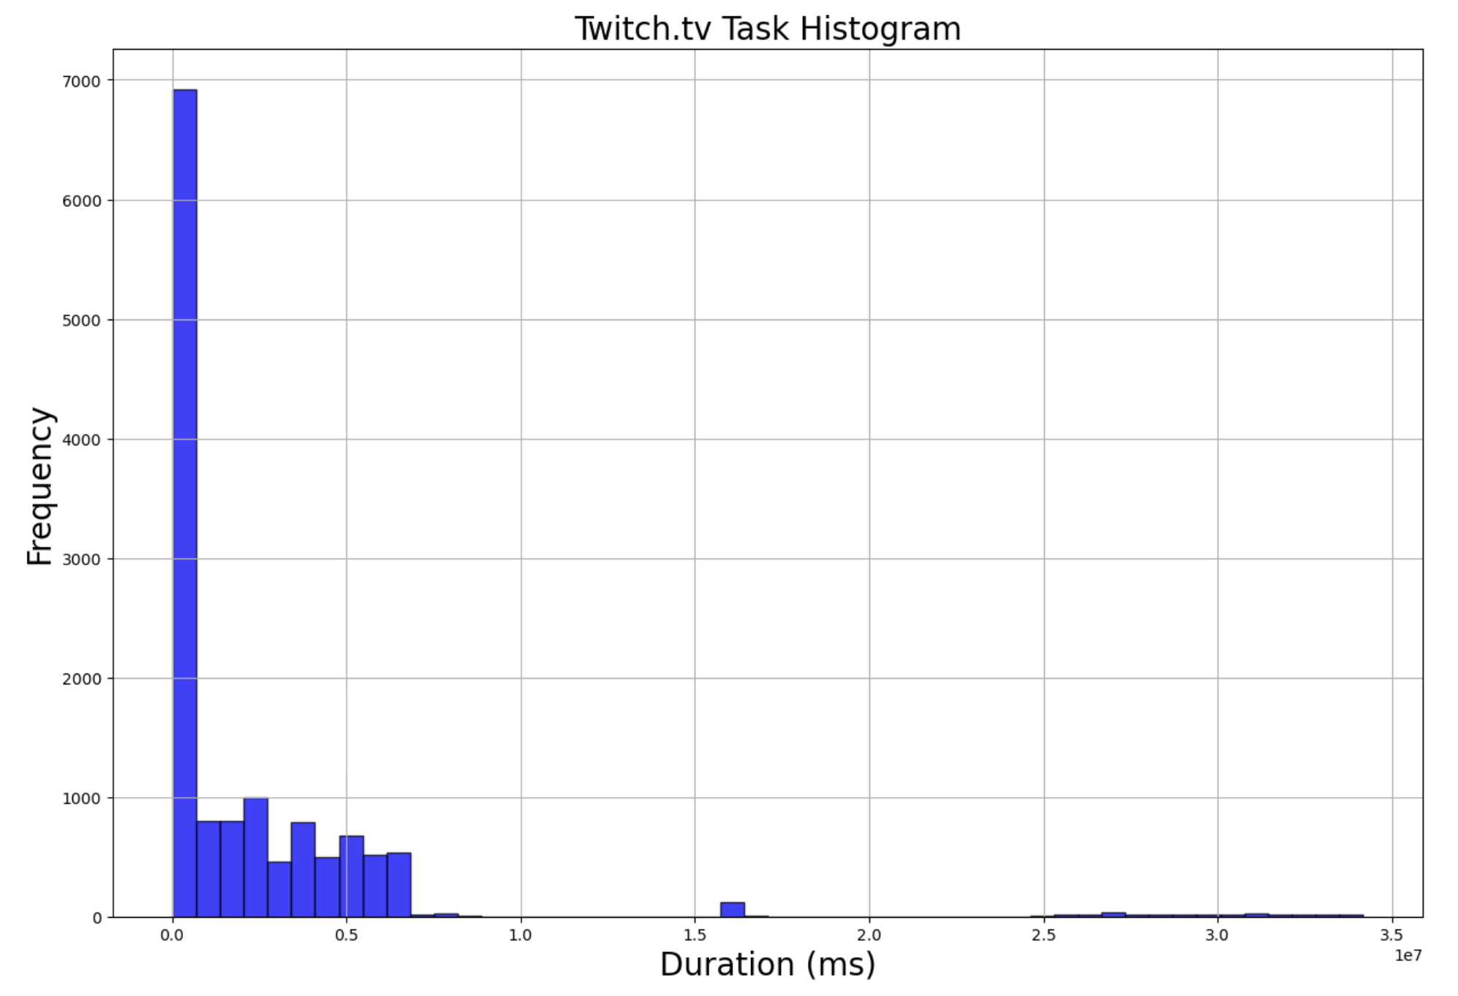

Slide 27
Can the adversary see a difference?

Slide 28
Yes!

Slide 29
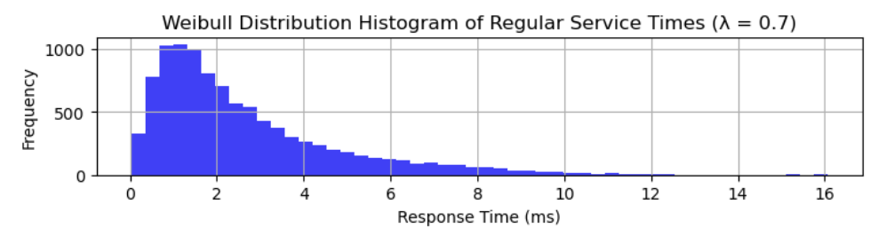
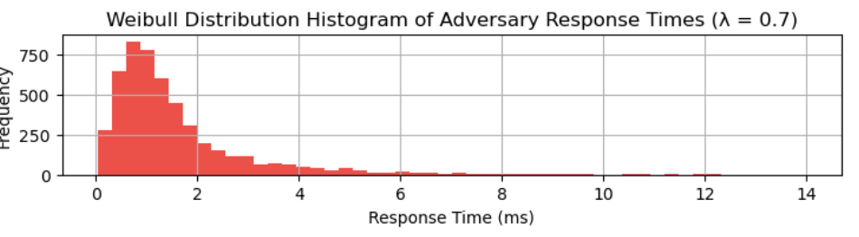
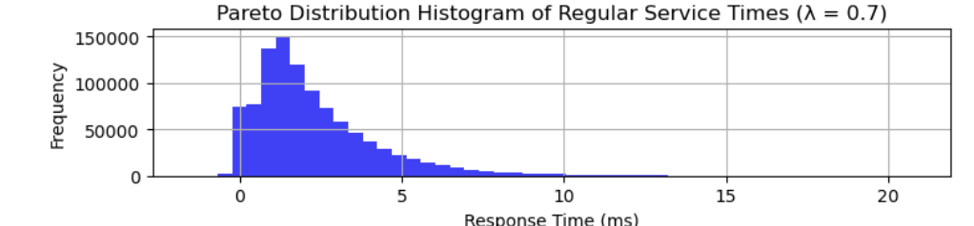
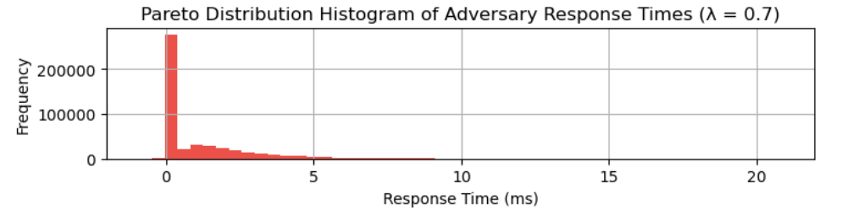
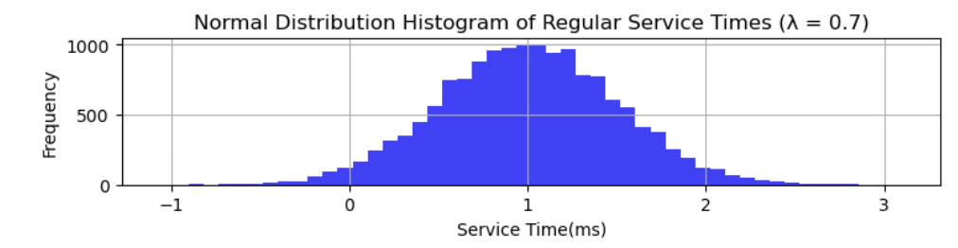
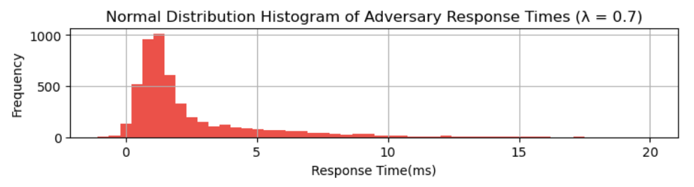
Output of Simulations
Regular Jobs
Adversary Jobs
VS
Notes:
By looking at the simulations we created.
We can assume an constant arrival rates and keep the average jobs size while varying the shape of the distribution. The goal is to demonstrate that by altering the distribution shape, the response time distribution for adversaries changes significantly, enabling them to distinguish between different types of traffic

Slide 30
Results
MERCURY
VENUS
Mercury is the closest planet
Venus has a beautiful name
JUPITER
NEPTUNE
Jupiter is the biggest planet
It’s the farthest planet

Slide 31
Conclusion
1
Queues are side-channels
2
Modifying the response time distribution can impact types of traffic.
3
As the blue graph fluctuates, the red graph shows notable changes, enabling an adversary to deduce which graphs were queued based on their patterns.
Notes:
By comparing the service time distribution of one tab with another tab using the same distribution and recording their mean response times, you can infer the activity of the other tab.

Slide 32
Future Work
1
Use Real Website Timing in Simulations
Build Working Implementation
2
3
Detect Mixture of Traffic from Multiple Sites

Slide 33



Thank you to my Mentors
UNC Faculty Mentor
Dr. Benjamin Berg
Intel Mentor:
Kiavash Satvat

Slide 34


Thank You

Slide 35
Thank you for Listening
Any Questions?

Slide 36
Instructions for use (free users)
In order to use this template, you must credit Slidesgo by keeping the Thanks slide.
You are allowed to:
Modify this template.
Use it for both personal and commercial purposes.
You are not allowed to:
Sublicense, sell or rent any of Slidesgo Content (or a modified version of Slidesgo Content).
Distribute this Slidesgo Template (or a modified version of this Slidesgo Template) or include it in a database or in any other product or service that offers downloadable images, icons or presentations that may be subject to distribution or resale.
Use any of the elements that are part of this Slidesgo Template in an isolated and separated way from this Template.
Delete the “Thanks” or “Credits” slide.
Register any of the elements that are part of this template as a trademark or logo, or register it as a work in an intellectual property registry or similar.
For more information about editing slides, please read our FAQs or visit Slidesgo School:
https://slidesgo.com/faqs and https://slidesgo.com/slidesgo-school

Slide 37
Instructions for use (premium users)
In order to use this template, you must be a Premium user on Slidesgo.
You are allowed to:
Modify this template.
Use it for both personal and commercial purposes.
Hide or delete the “Thanks” slide and the mention to Slidesgo in the credits.
Share this template in an editable format with people who are not part of your team.
You are not allowed to:
Sublicense, sell or rent this Slidesgo Template (or a modified version of this Slidesgo Template).
Distribute this Slidesgo Template (or a modified version of this Slidesgo Template) or include it in a database or in any other product or service that offers downloadable images, icons or presentations that may be subject to distribution or resale.
Use any of the elements that are part of this Slidesgo Template in an isolated and separated way from this Template.
Register any of the elements that are part of this template as a trademark or logo, or register it as a work in an intellectual property registry or similar.
For more information about editing slides, please read our FAQs or visit Slidesgo School:
https://slidesgo.com/faqs and https://slidesgo.com/slidesgo-school

Slide 38
Infographics
You can add and edit some infographics to your presentation to show your data in a visual way.
Choose your favourite infographic and insert it in your presentation using Ctrl C + Ctrl V or Cmd C + Cmd V in Mac.
Select one of the parts and ungroup it by right-clicking and choosing “Ungroup”.
Change the color by clicking on the paint bucket.
Then resize the element by clicking and dragging one of the square-shaped points of its bounding box (the cursor should look like a double-headed arrow). Remember to hold Shift while dragging to keep the proportions.
Group the elements again by selecting them, right-clicking and choosing “Group”.
Repeat the steps above with the other parts and when you’re done editing, copy the end result and paste it into your presentation.
Remember to choose the “Keep source formatting” option so that it keeps the design. For more info, please visit Slidesgo School.

